Slide 1
Leveraging Nested Data Frames for Analytical Studies
Mike Mehan | Staff Bioinformatics Scientist
10.14.2020
QB# 11065

Slide 2



Markets
ONCOLOGY^{1,2}
cWGS^{3,4}
NIPT⁵⁻⁷
200+ histological types of cancer
17M+ new cases of cancer worldwide in 2018
9.6M deaths from cancer worldwide in 2018
7000+ genetic disorders
250M+ people with a genetic disease worldwide
~5+ years for a diagnosis
40M pregnancies worldwide
1/50 afflicted by a genetic abnormality
~20% of pregnancies suffer a serious
complication
1. Cancer Research UK https://www.cancerresearchuk.org/about-cancer/what-is-cancer 2. WHO International Agency for Research on Cancer. https://www.who.int/cancer/PRGlobocanFinal.pdf 3. Global Genes RARE Facts & Statistics: https://globalgenes.org/rare-facts/ 4. Rare Disease Impact Report: Insights from patients and the medical community. Shire. 2013. 5. 2016 World Population Data Sheet http://www.prb.org/pdf16/prb-wpds2016-web-2016.pdf 6. http://en.wikipedia.org/wiki/List_of_countries_by_population. 7. http://en.wikipedia.org/wiki/List_of_sovereign_states_and_dependent_territories_by_birth_rate
Notes:
Already approved under QB# 8363

Slide 3
Assessing Analytical Performance
Analytical performance of assays must be evaluated
Examples: Limit of Detection, Precision, Stability
Study designs often require repeating similar analyses on multiple samples or conditions
Multiple positive samples
Multiple reagent lots
Multiple analytes for multiplexed assays
Results must be traceable and reproducible
Analysis notebooks
Results as flat files or serialized objects
Event 1
Pos 1
Lot A
Lot B
Pos 2
Lot A
Disease Types
Positive Samples
Lots
Lot B

Slide 4
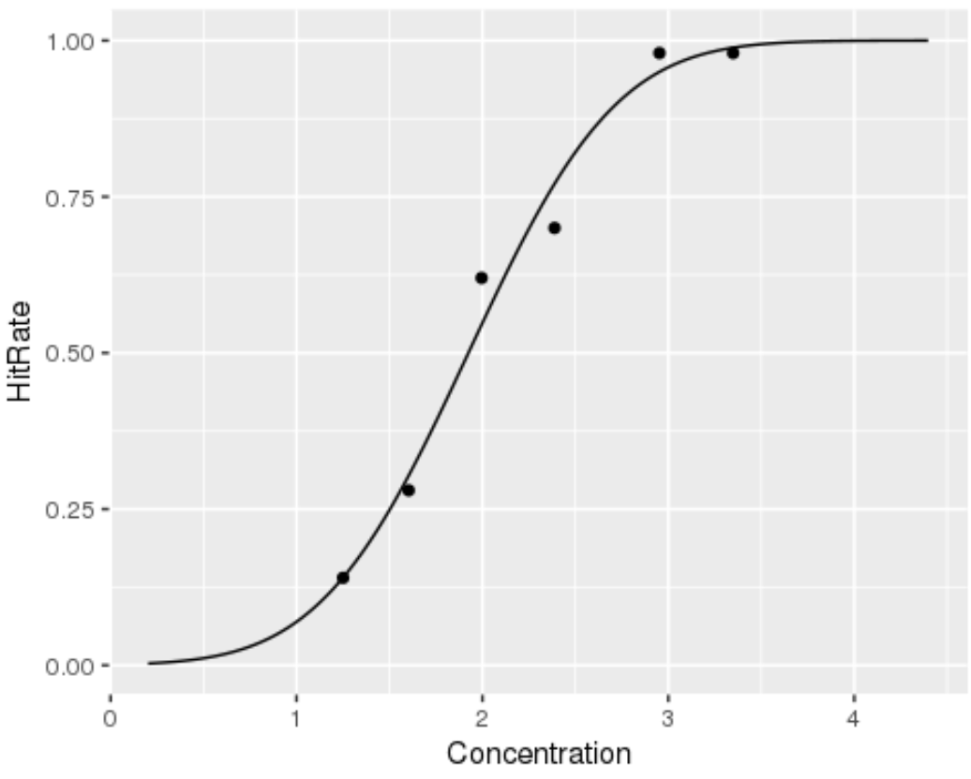
Simulated Limit of Detection Study
Simulated design
3 disease (event) types
3 affected (positive) samples per event
2 lots
Limit of Detection (LoD)
Estimate relationship between event detection and analyte concentration (probit regression)
LoD is the concentration with a detection rate of 95%
Detection rate (hitrate) is the number of replicates detected at a particular concentration

Slide 5
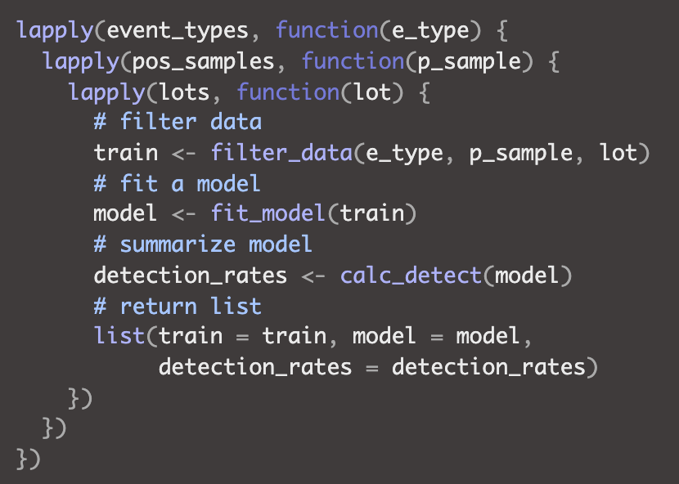
Nested Analysis Example
Common coding pattern using apply (or map) family of functions
Iterate over study levels
Perform analysis
Return nested list

Slide 6
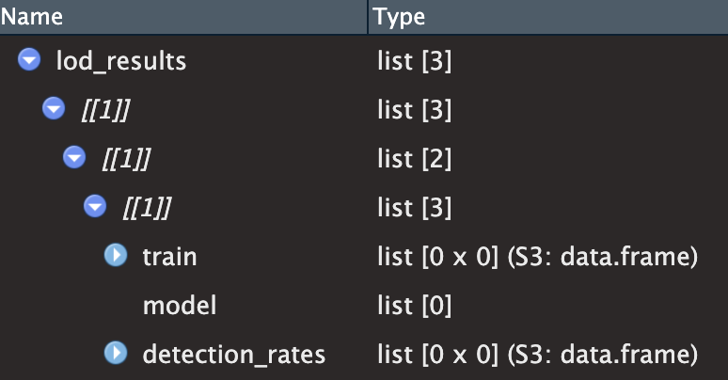
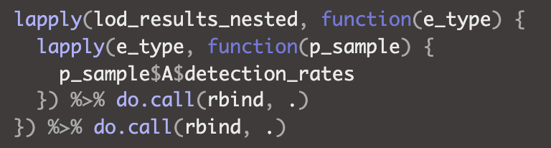
Impact on Traceability & Reproducibility
The structure isn’t always obvious from the object
Object structure needs to be documented
Summarizing study design requires recursing the list
Extracting/filtering results can be clumsy due to structure
“Get all detection rates for Lot A”
Downstream analysis often requires custom code that reflects nested structure

Slide 7
What Are Nested Data Frames?
Typical data frames contain a collection (list) of vectors
Each vector contains scalars of a particular type
A nested data frame can contain a mix of vectors and lists
Allows more complex data types to be stored in data frames
Supports nested structures/designs
Allows the use of the tidyverse
EventType
Positive Sample
Lot
Score
EventType
Positive Sample
Lot
Score
GLM
E1
E1
E1
E1
E1
E1
…
1
2
3
1
2
3
…
A
A
A
B
B
B
…
#
#
#
#
#
#
E1
E1
E1
E1
E1
E1
…
1
2
3
1
2
3
…
A
A
A
B
B
B
…
#
#
#
#
#
#
glm
glm
glm
glm
glm
glm

Slide 8
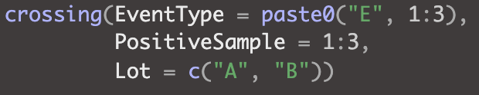
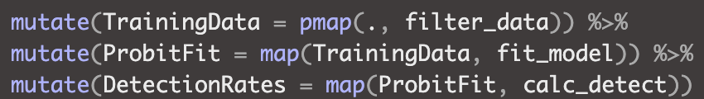
Revisiting the Nested Analysis Example
Create a data frame containing all conditions
Data from each stage of the analysis is stored in a separate column
Positive Sample
filter_data()
TrainingData
fit_model()
calc_detect()
Detection Rates
EventType
Lot
ProbitFit
E1
E1
E1
E1
E1
E1
…
1
2
3
1
2
3
…
A
A
A
B
B
B
…
data.frame
data.frame
data.frame
data.frame
data.frame
data.frame
…
glm
glm
glm
glm
glm
glm
…
data.frame
data.frame
data.frame
data.frame
data.frame
data.frame
…

Slide 9
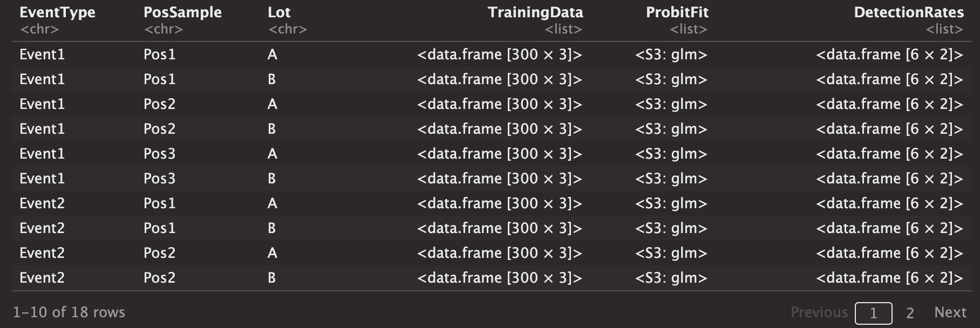
Improved traceability and reproducibility
The structure is far more intuitive
Scales easily for large studies
Study Design
Analysis Steps

Slide 10
Improved traceability and reproducibility
Single starting point for all downstream plots/tables
Study conditions and results are all linked via rows in the data frame
Summarize replicates & failures, for the first event type
Plot model fits for the second event type within Lot A

Slide 11
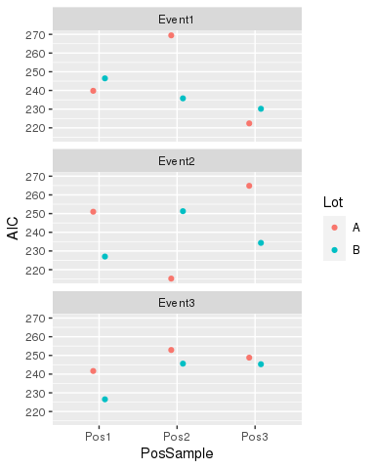
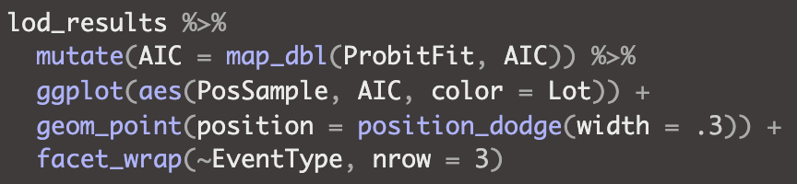
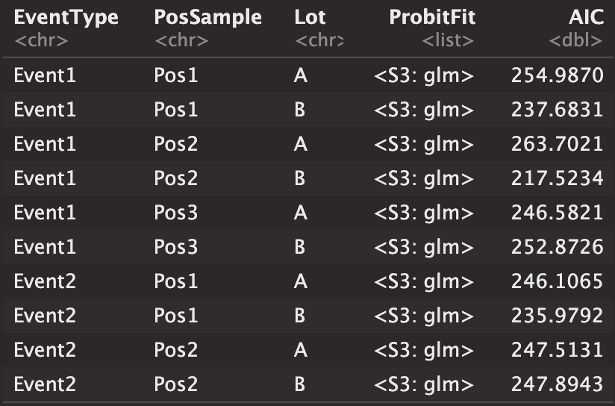
Example 1: Goodness of Fit Plots
Study conditions and results on same row allow for easy plotting
Add column derived from GLM fit

Slide 12
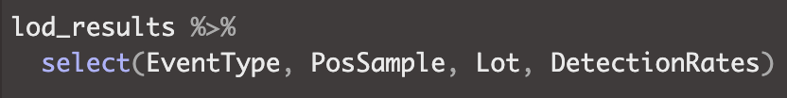
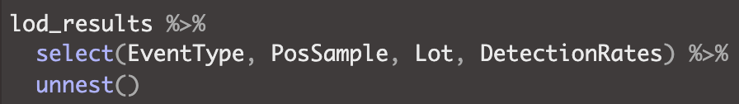
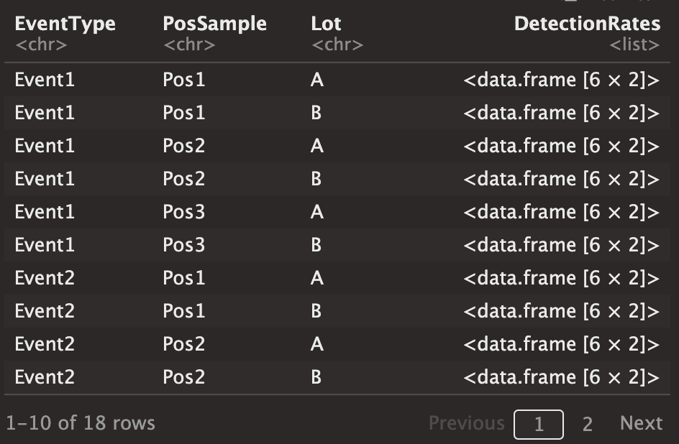
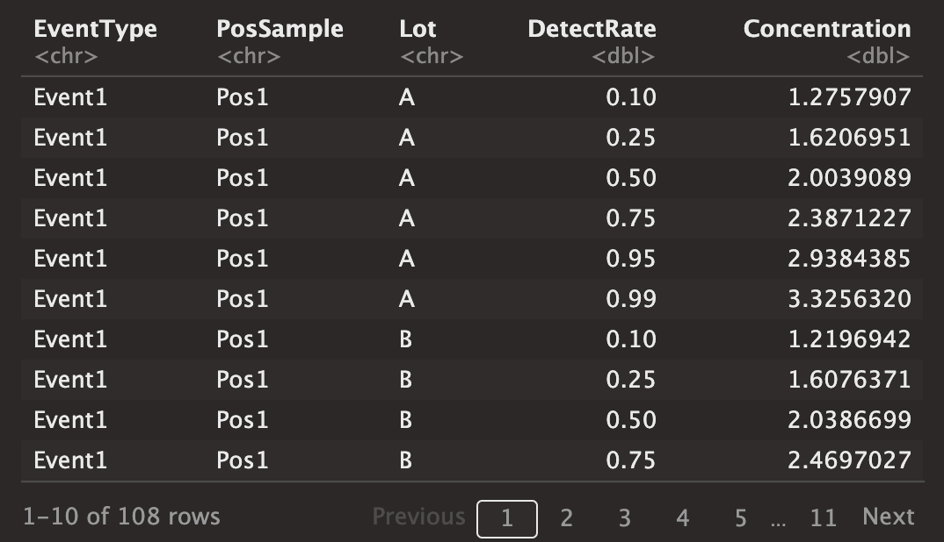
Example 2: Max LoD For Each Sample
Select required columns
Still have 18 rows (3 x 3 x 2)
Followed by unnest()
Expands to 108 rows (3 x 3 x 2 x 6)

Slide 13
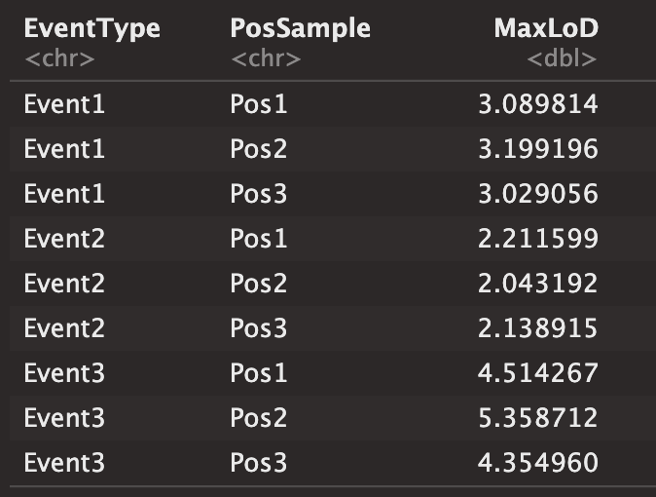
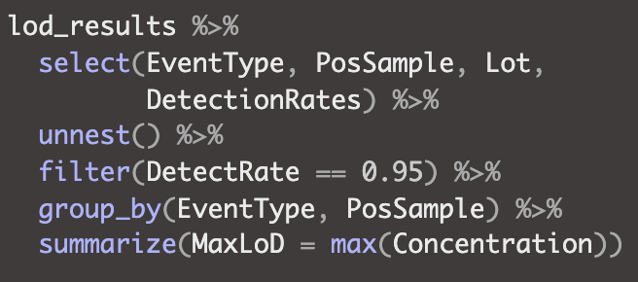
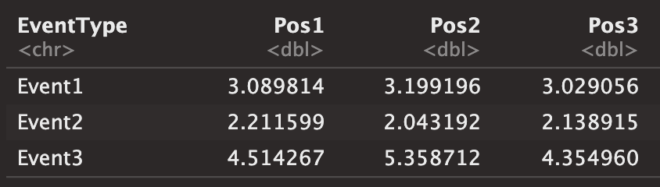
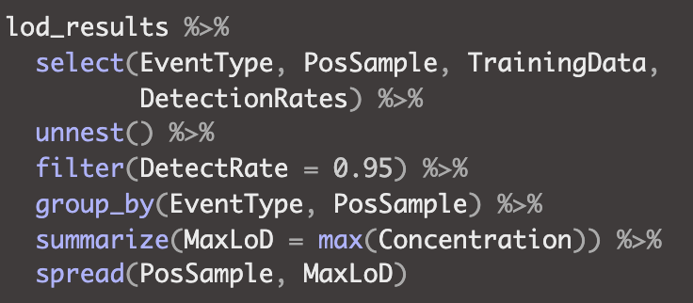
Example 2: Max LoD For Each Sample
Now we can finish off with standard tidyverse summarization
Or spread for easier viewing

Slide 14
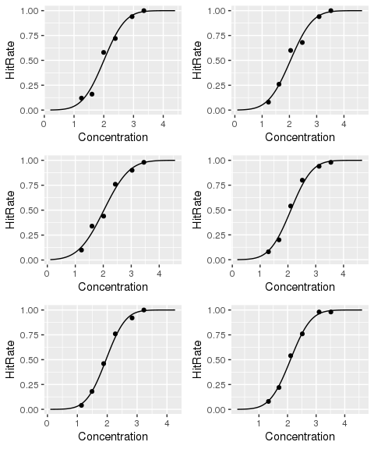
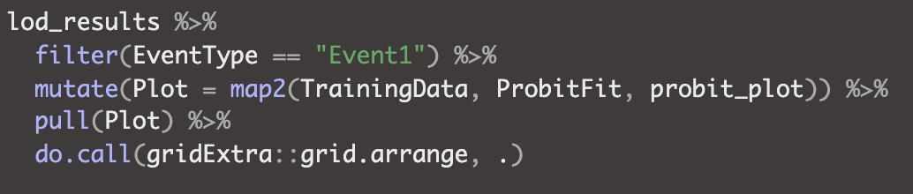
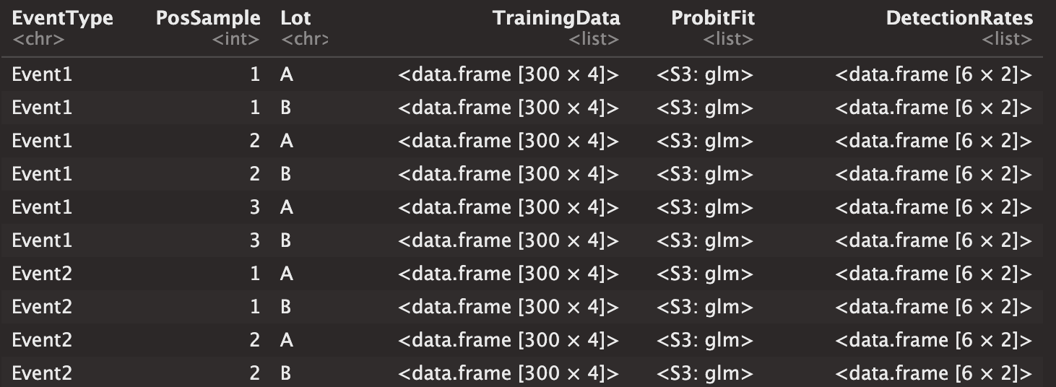
Example 3: Create Plots for One Event
The map2 family of functions can be used to combine data from two columns

Slide 15
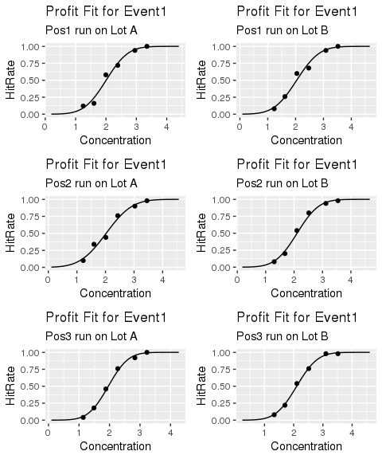
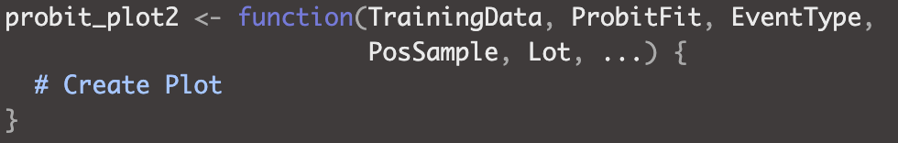
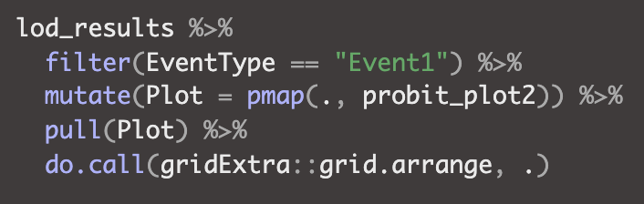
Example 3: Create Plots for One Event
The pmap family of functions allows the combination of multiple columns
Define a function with arguments that match column names
Pass the entire data frame via pmap DFs are lists, so it will pull the columns by name

Slide 16
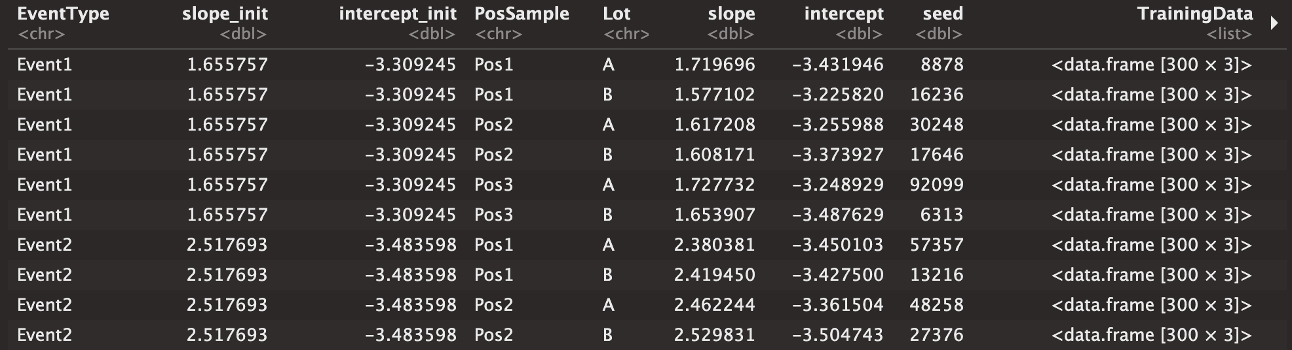
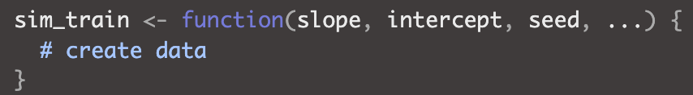
Reproducibility and pmap
The use of pmap encourages all function arguments to be stored in the data frame rather than passed manually in notebook
Reproducibility is now modular, rather than being tethered to the rendering of a notebook.
Example: simulated data for this presentation
Random starting coefficients for each event type
Fold in PosSample and Lot, jitter coefficients
Set seed and simulate training data
ProbitFit
DetectRates

Slide 17
Summary
Traceability and Reproducibility
Data structure is more intuitive (column names)
Helpful when returning to old analysis
Forces you to organize dependences and steps
A nested data frame enforces local scope
Dependencies like random seeds are embedded
Modular data set that can be analyzed independently of source notebook
Facilitates follow-up work, validation, and collaboration
Efficiency & Scalability
Tidyverse can be used directly rather than developing custom code to package data
Once an analysis workflow is designed for a replicate, it can be applied to all other replicates simply by adding rows to the data frame

